Slide 1
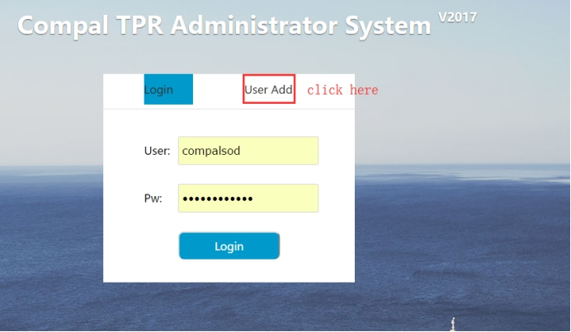
Q:How to login in User Add System?
A:Be sure your ip address is in web server whitelist

Slide 2
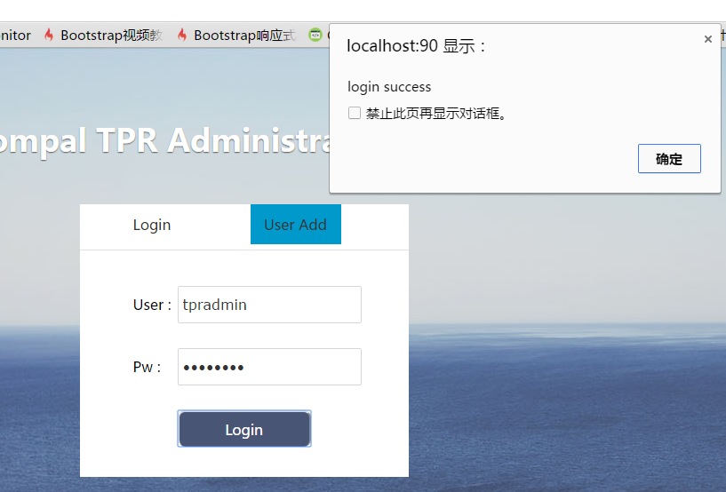
Ok! Login success!

Slide 3
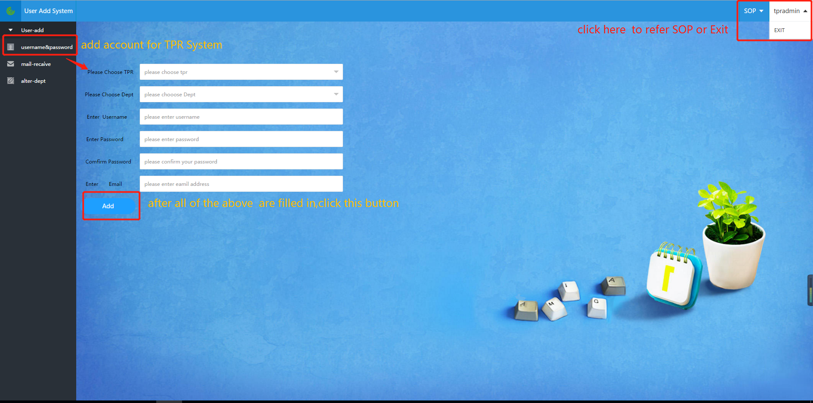
Q:how to operate it? A:

Slide 4
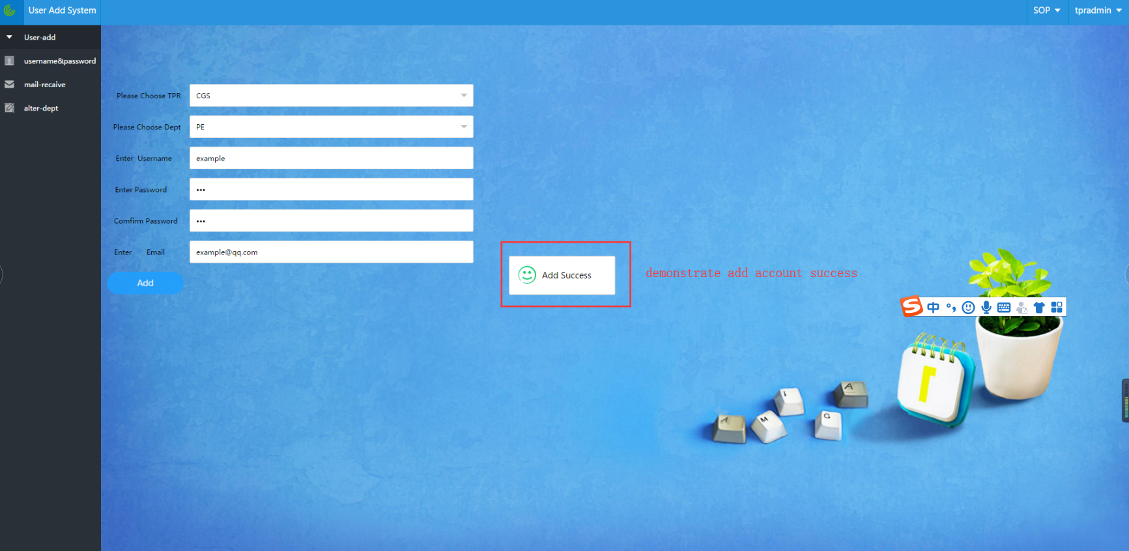

Slide 5
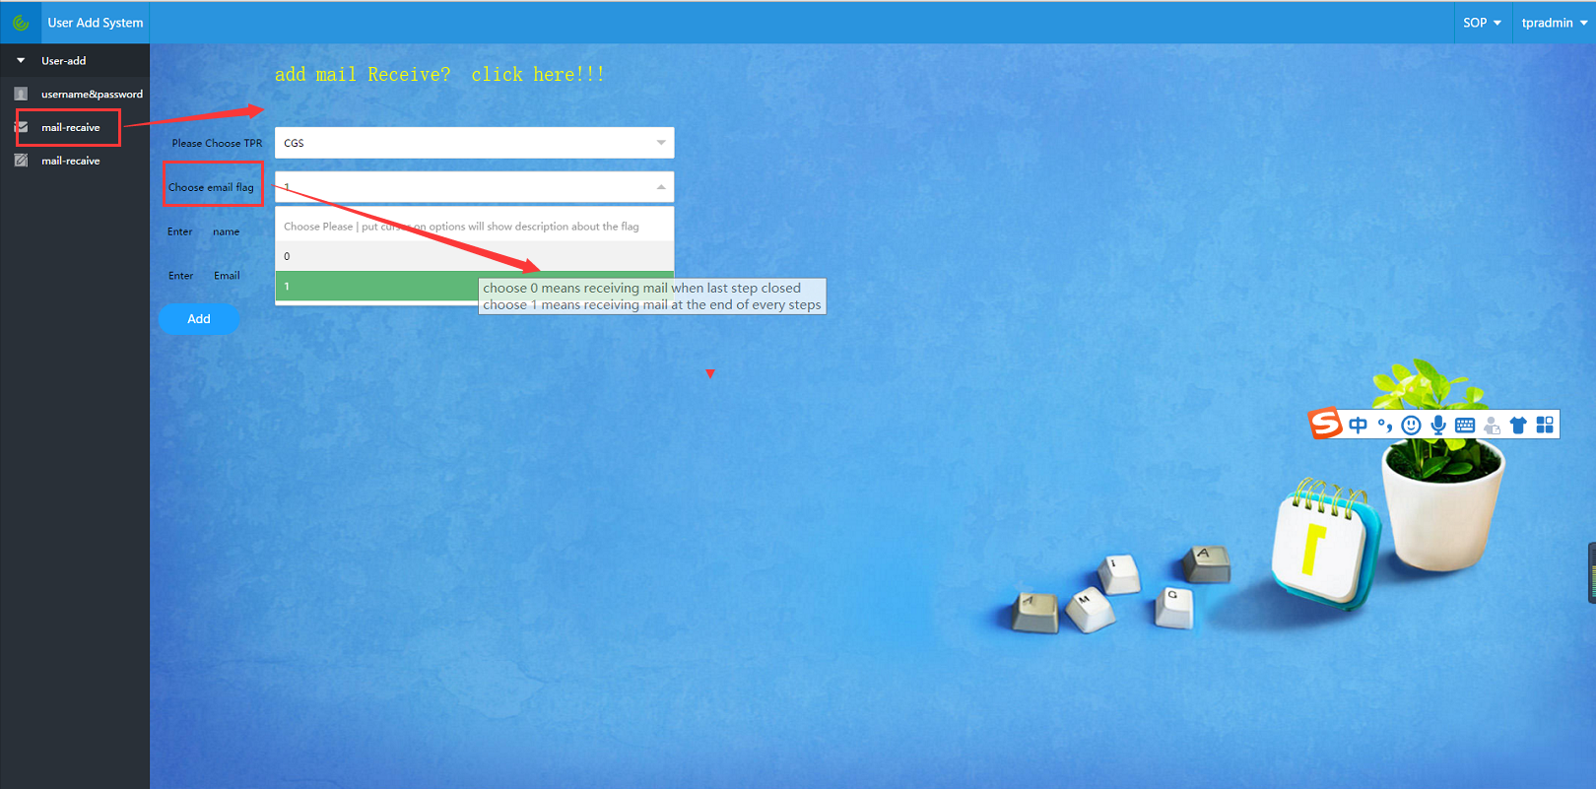

Slide 6
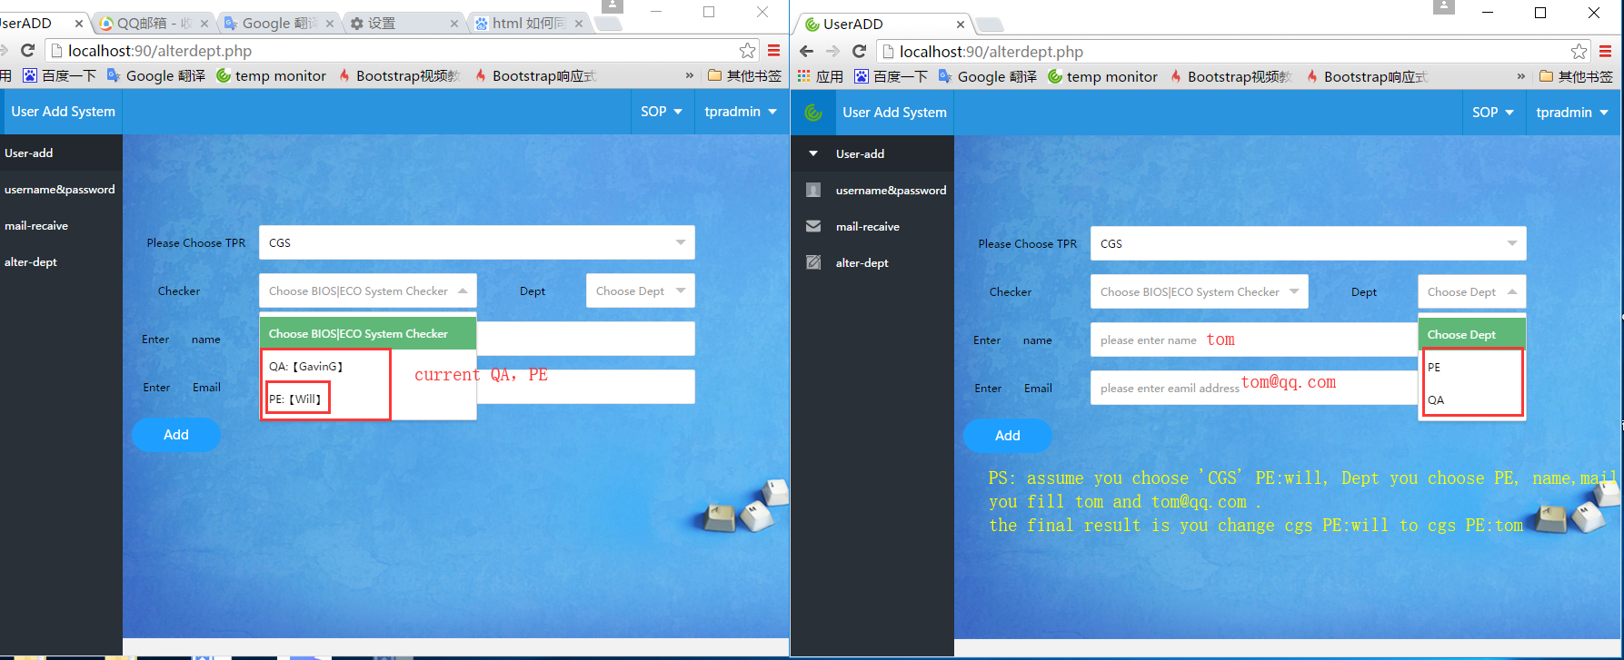

Slide 7
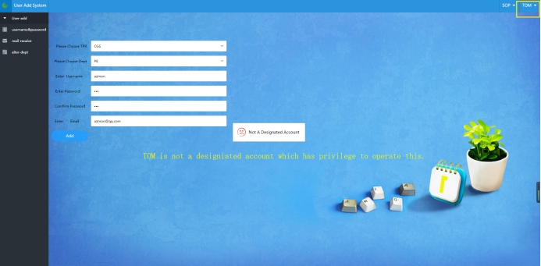
Q:why cann’t you operate success?

